Slide 1
Kubernetes Lab
By
Arun

Slide 2
1. Initializes cluster master node:
kubeadm init --apiserver-advertise-address $(hostname -i)

Slide 3
kubectl apply -n kube-system -f \
"https://cloud.weave.works/k8s/net?k8s-version=$(kubectl version | base64 |tr -d '\n')"

Slide 4
kubeadm join --token e67433.f4df07453b458c0d 192.168.0.5:6443 --discovery-token-ca-cert-hash sha256:c7d29b2c41c377ef76e5db9803117e693c22376cc5e9a9bafe0a44d3edf8bed4

Slide 5
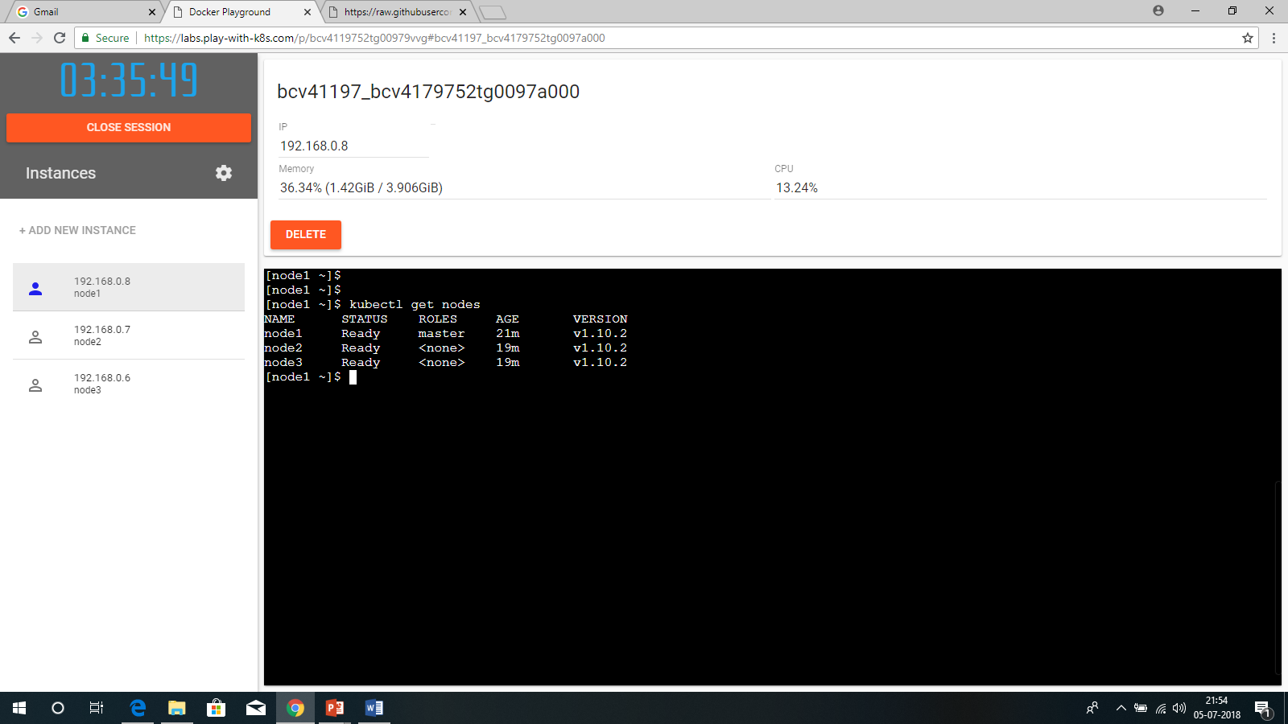

Slide 6


Slide 7


Slide 8


Slide 9


Slide 10


Slide 11
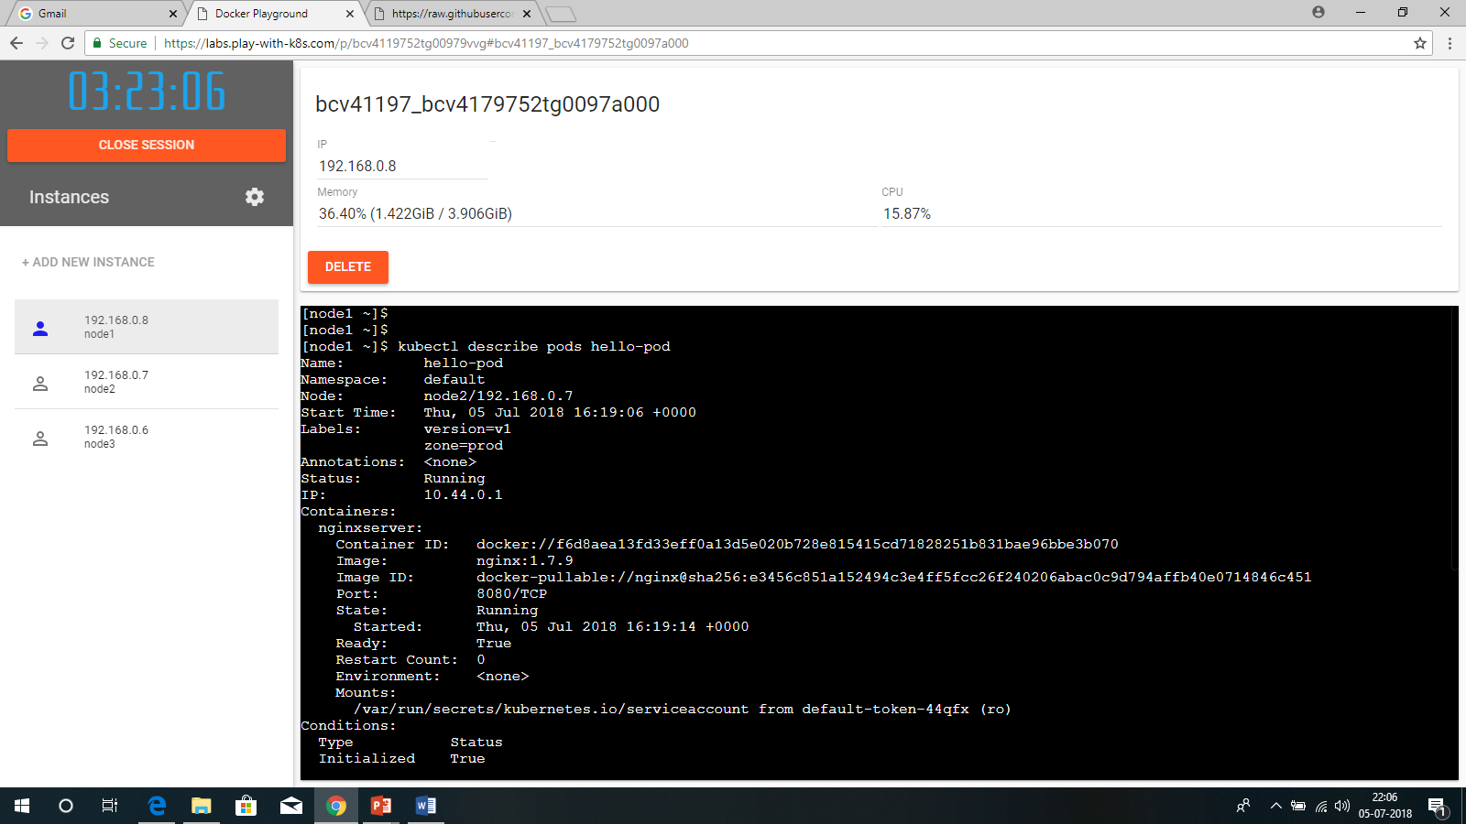

Slide 12


